Slide 1
TRILLIONS
Tuesday, December 3,2019
By:
Shilpa Agrawal
Pedro Takenouchi
Carl Tondo Columbia University
Maria Jose Siles Navarro. Data Analytics

Slide 2

Company Profile
Alphabet is a holding company, with Google, the Internet media giant, as a wholly owned subsidiary. Google generates 99% of Alphabet revenue, of which more than 85% is from online ads. Google’s other revenue is from sales of apps and content on Google Play and YouTube, as well as cloud service fees and other licensing revenue. Sales of hardware such as Chromebooks, the Pixel smartphone, and smart homes products, which include Nest and Google Home, also contribute to other revenue. Alphabet’s moonshot investments are in its other bets segment, where it bets on technology to enhance health (Verily), faster Internet access to homes (Google Fiber), self-driving cars (Waymo), and more. Alphabet’s operating margin has been 25%-30%, with Google at 30% and other bets operating at a loss.

Slide 3
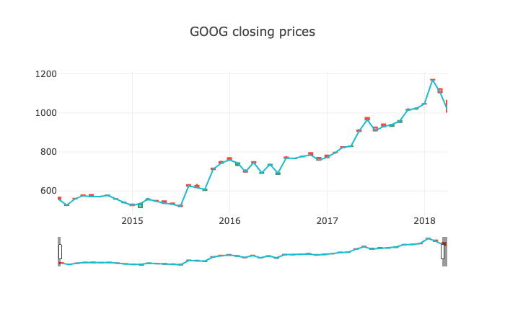
Stock Performance

Slide 4

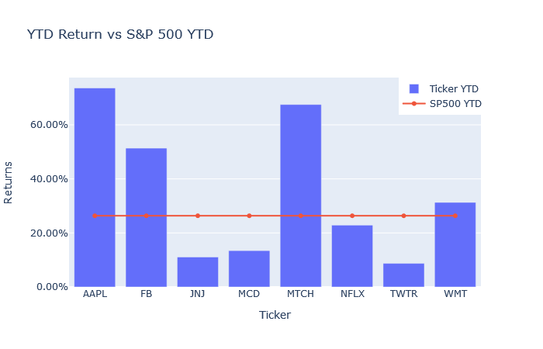
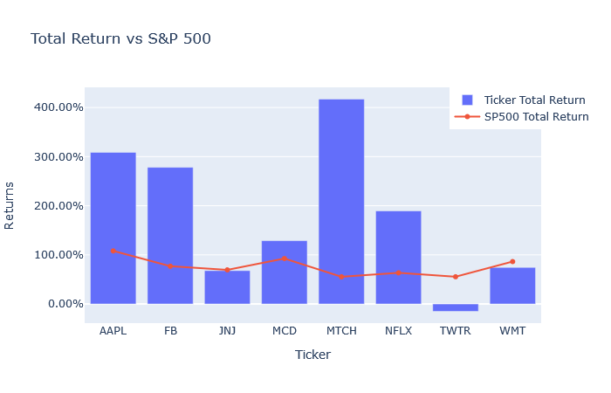

Slide 5
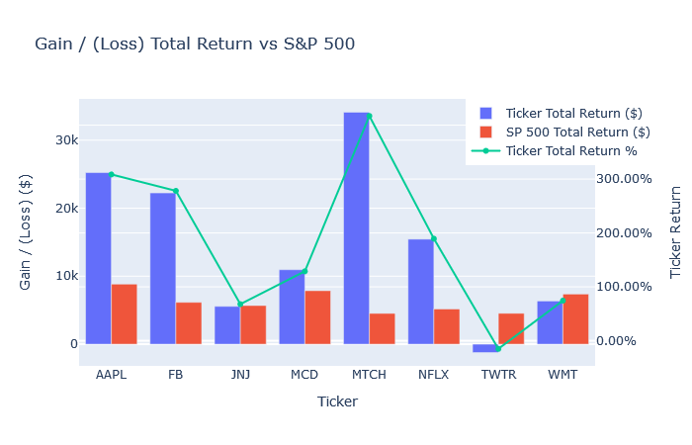
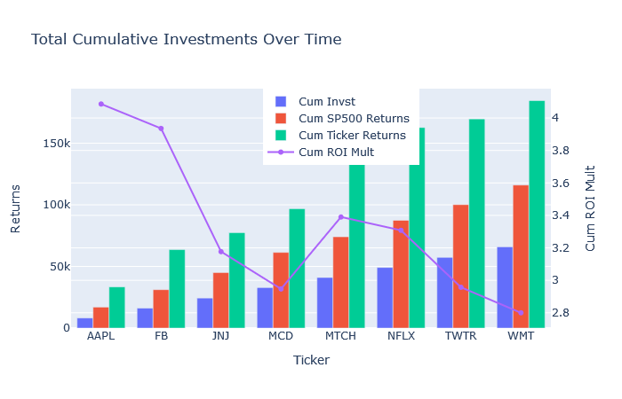

Slide 6
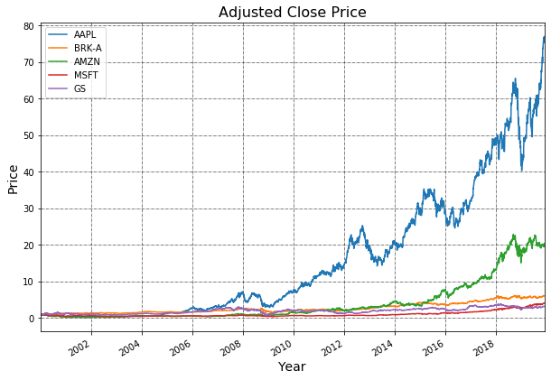
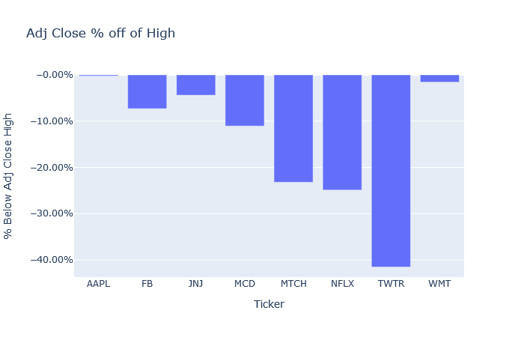

Slide 7
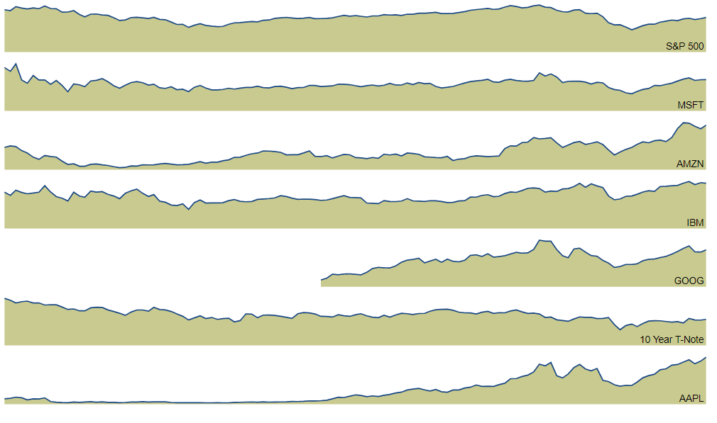
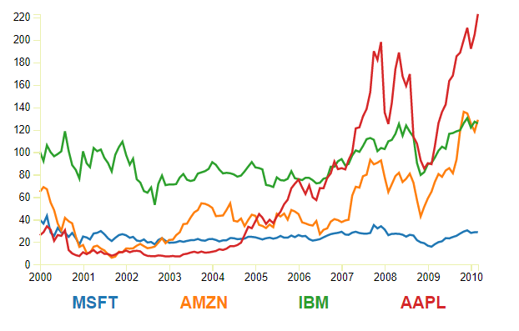

Slide 8
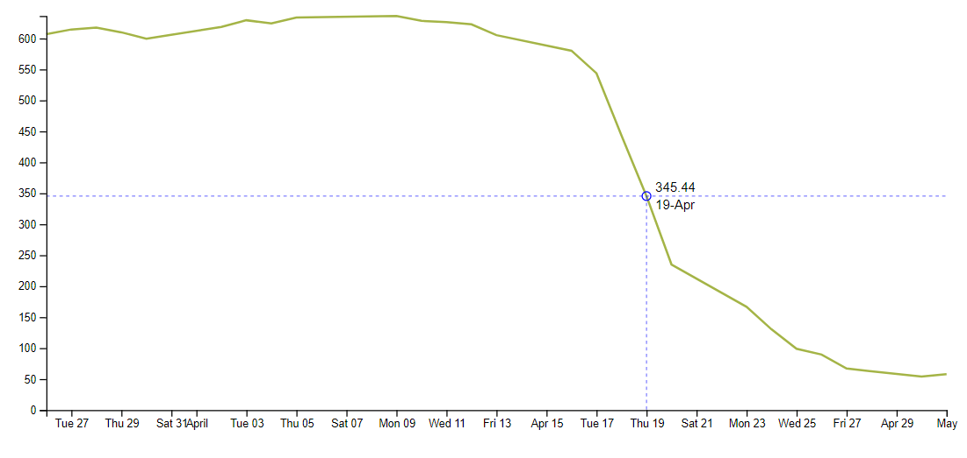

Slide 9
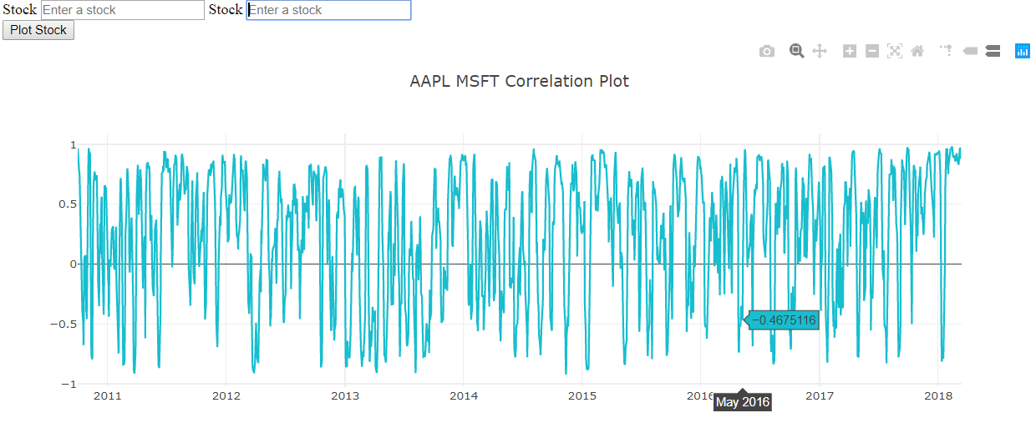
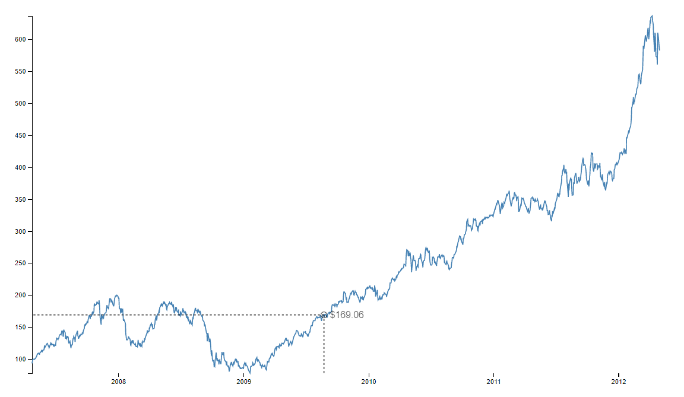

Slide 10
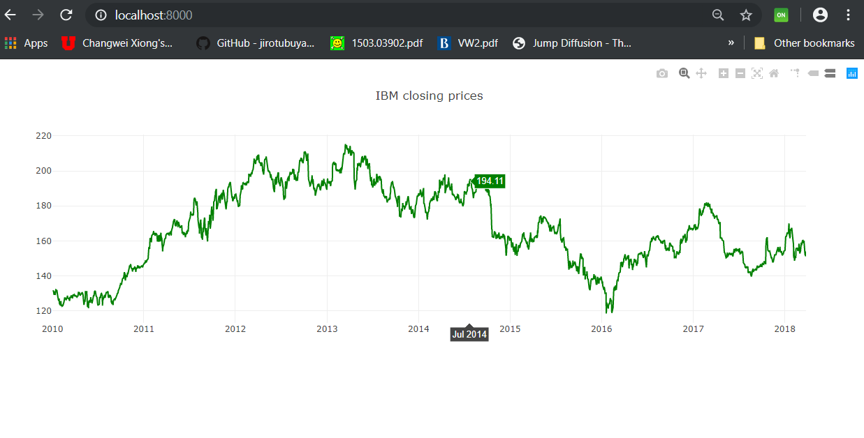
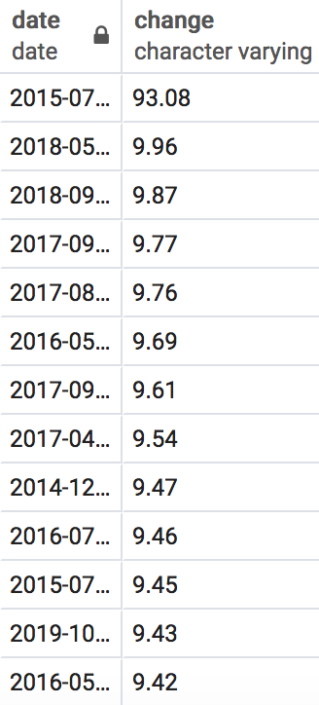
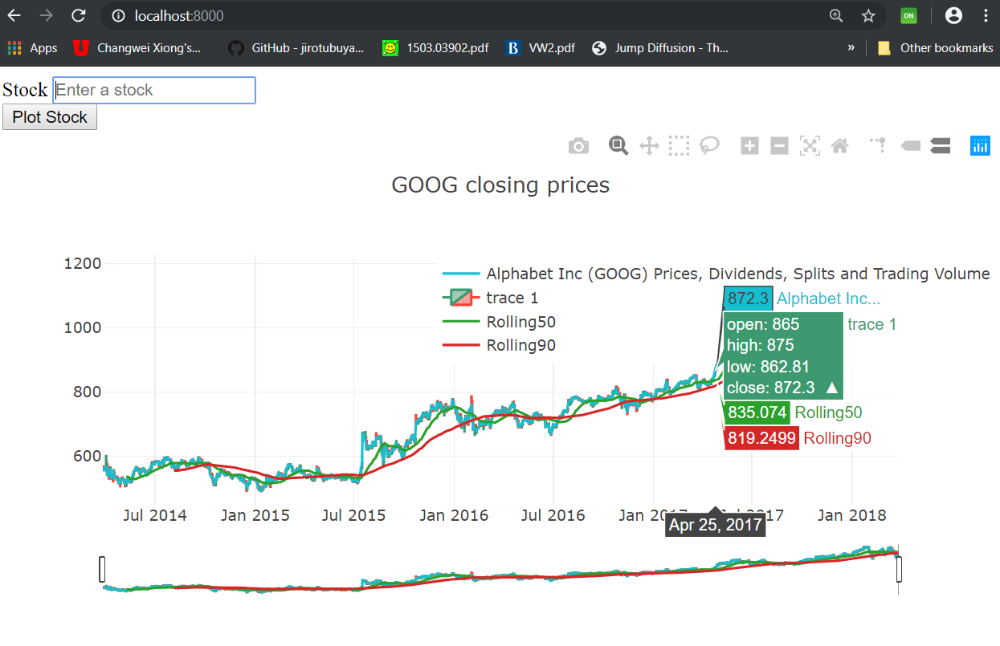
GooG Changes

Slide 11
References
D3 / Babel / Plotly (JavaScript)
https://bl.ocks.org/d3noob/f8b7f107ba25c21971851728520224cb
https://bl.ocks.org/mbostock/1157787
https://bl.ocks.org/d3noob/892237b3a71faf26c07b0563963c7b6e
https://bl.ocks.org/micahstubbs/e4f5c830c264d26621b80b754219ae1b
https://www.freecodecamp.org/news/how-to-build-historical-price-charts-with-d3-js-72214aaf6ba3/
Python – Plotly (Jupyter Notebook) – Stock Visualization and Analysis
https://medium.com/@ishan.s_54240/stock-data-and-analysis-529aa9aee60
https://towardsdatascience.com/python-for-finance-stock-portfolio-analyses-6da4c3e61054
https://www.kaggle.com/kratisaxena/stock-market-technical-indicators-visualization/comments#560477
https://towardsdatascience.com/python-for-finance-stock-portfolio-analyses-6da4c3e61054
https://medium.com/@samanamp/fetching-live-stock-market-data-with-python-and-alphavantage-7d0ff8a8d2e4

